Slide 1
Jenkins and Docker
Angular Web Apps

Slide 2
Set Up Jenkins

Slide 3
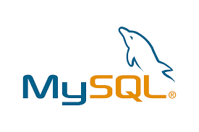
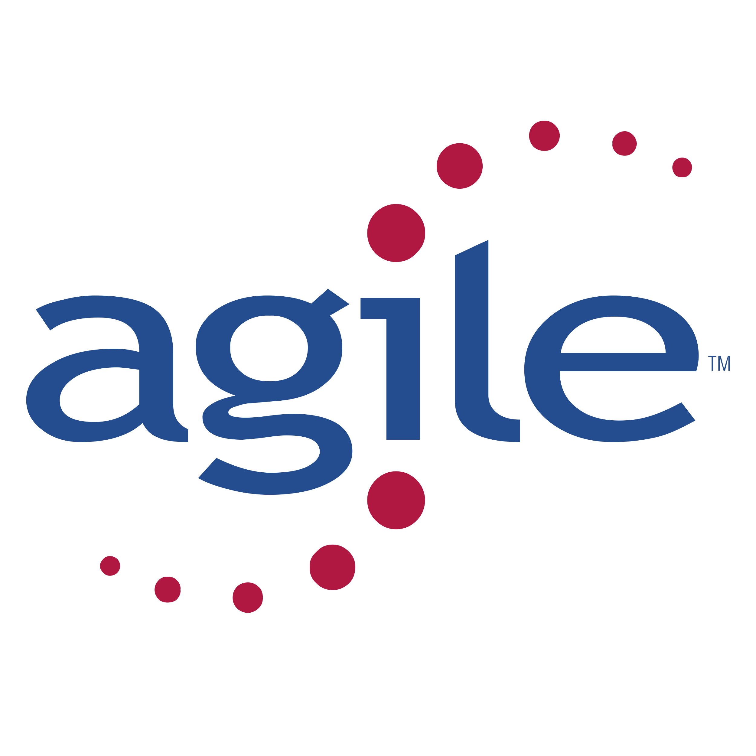
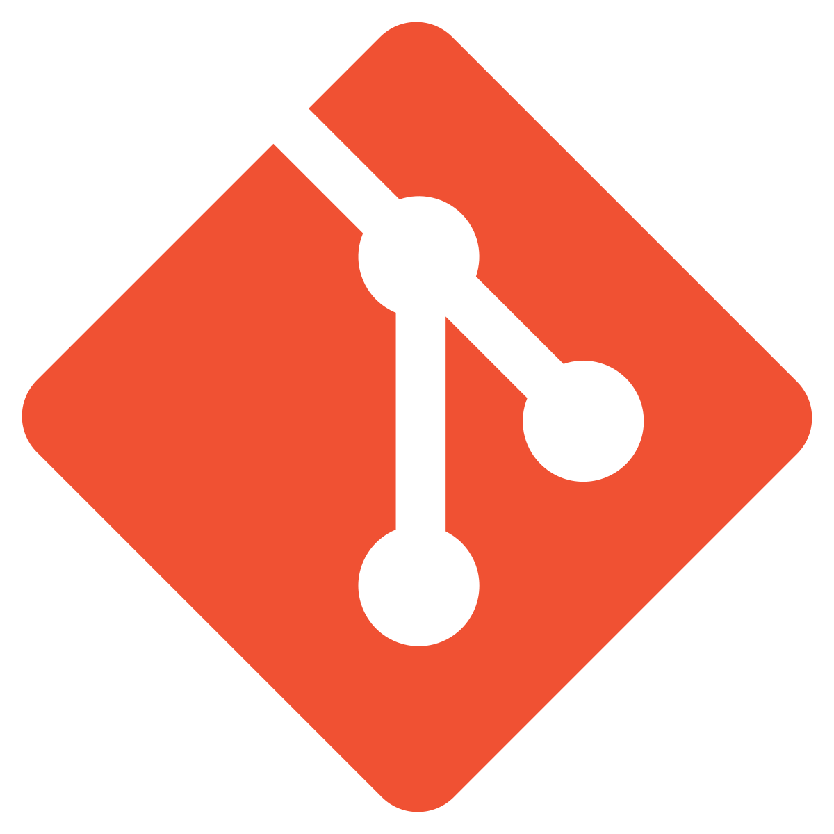
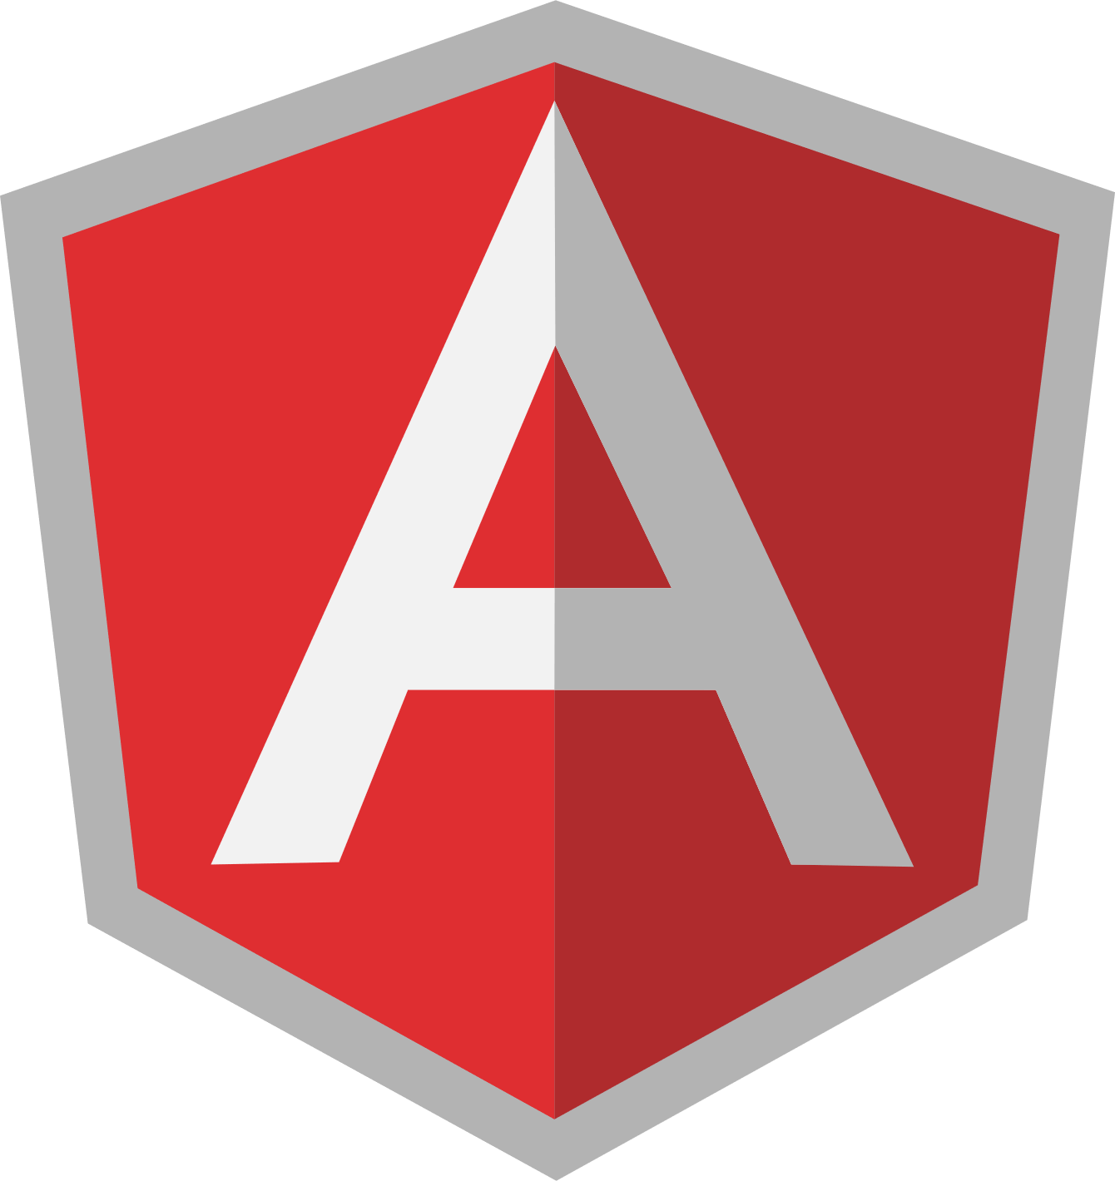
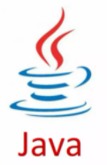
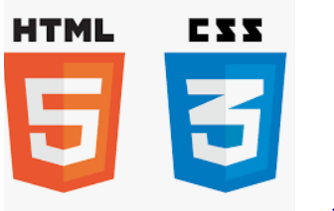

Before we begin, let’s recall what we have covered till now:
Agile
Git
SQL
Angular
HTML
CSS
JavaScript
Core java

Slide 4
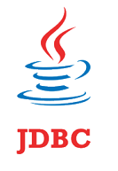

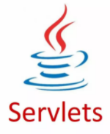


Before we begin, let’s recall what we have covered till now:
JDBC
JSP
Servlets
MongoDB
Maven

Slide 5

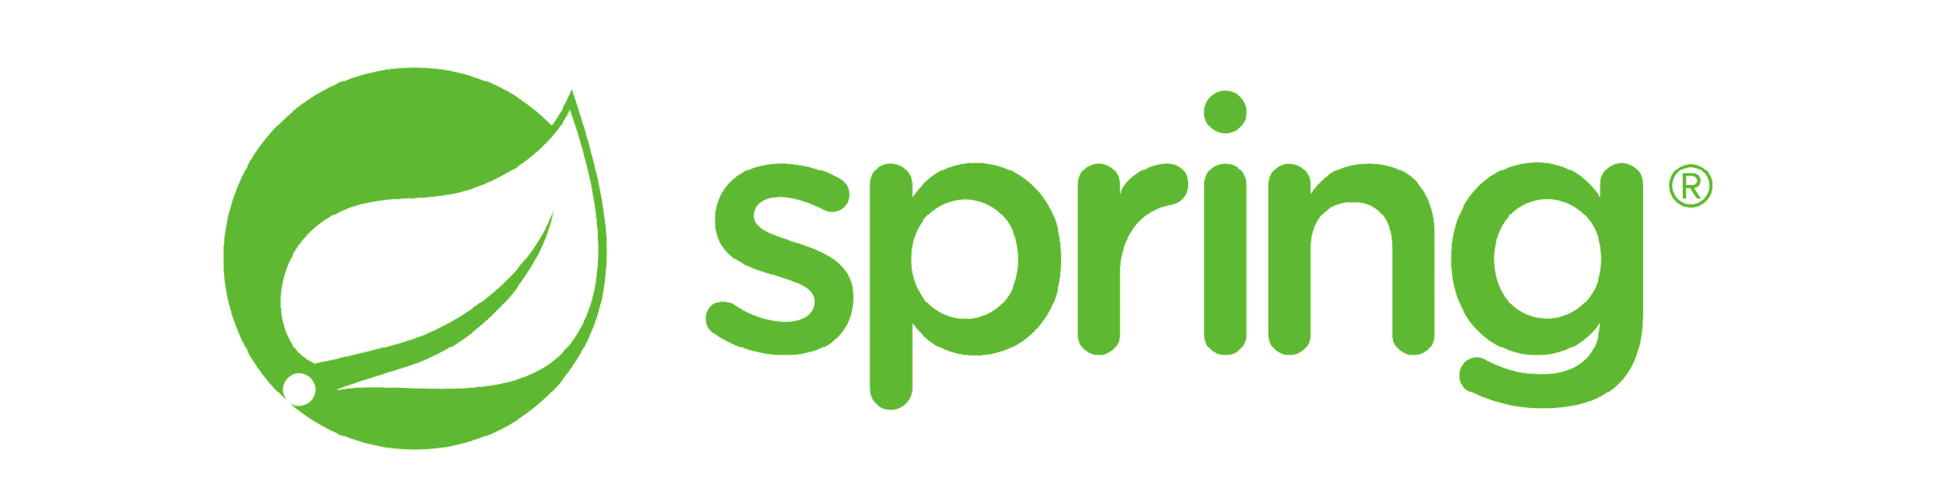

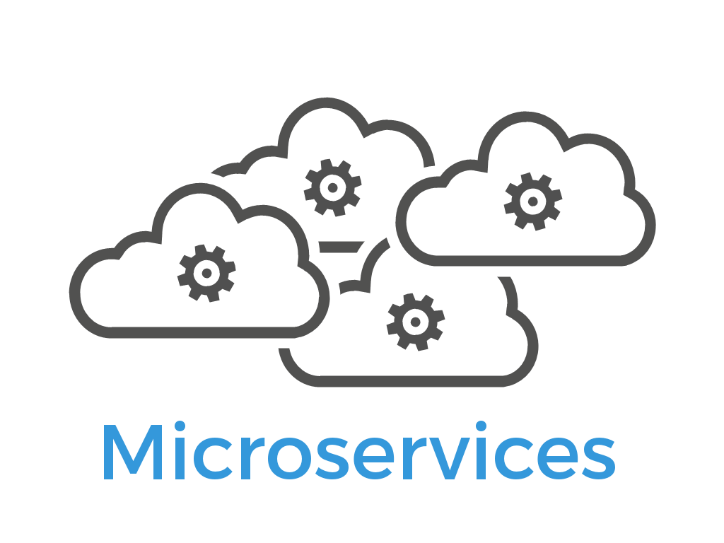
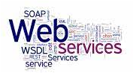
Before we begin, let’s recall what we have covered till now:
JUnit
Spring
Spring Boot
Webservices
Microservices

Slide 6
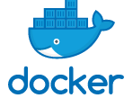
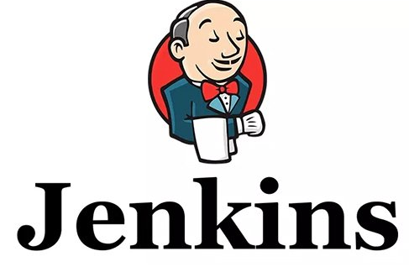

Before we begin, let’s recall what we have covered till now:
Docker
Jenkins
AWS

Slide 7
Developed Angular Front End
Created various components and services for the Angular eStore admin and end user.
Developed Java Back End
Developed the Java back end for the admin and the end-user
Implemented microservices with Spring Boot
Front-End Back-End Communication
Used HTTP Client in Angular to communicate with the Java back end
Implemented communication for both the admin and the end-user projects

Slide 8
As a full stack web developer, our key role is to develop both client and server software.
Angular and Node can be used to build the front end of the web page.
Spring Boot, Java, and MySQL or MongoDB can be used to build at the back end.

Slide 9

Bob needs to develop Angular web apps for the admin and the end user.
He brainstorms a bit and finds a solution.
Let me use Jenkins, Docker, and AWS to build CI/CD Pipelines, containerize the apps, and finally host them to AWS EC2 instance.
In this lesson, we will create Jenkins Pipeline for CI/CD for Java back end. Moving ahead, we will create a Dockerfile to build images, run them as containers in Docker, and help Bob complete his task effectively and quickly.

Slide 10

Create Jenkins Pipeline
Implement CI/CD in Jenkins with Git
Create a Dockerfile for building images
Integrate Docker in Jenkins to build and release the images as containers

Slide 11
Set Up Jenkins for the Angular Web-Admin Project

Slide 12

Jenkins
Jenkins is an automation build server used for tasks such as; building, testing, and deploying software.
Dev
Ops
Jenkins plays an important role in developing continuous integration and continuous delivery pipelines.
Notes:
Jenkins is an automation build server with which you can automate software development related tasks such as building, testing, and deploying the software. It plays an important role in the industry when it comes to DevOps i.e. developing continuous integration and continuous delivery pipelines

Slide 13
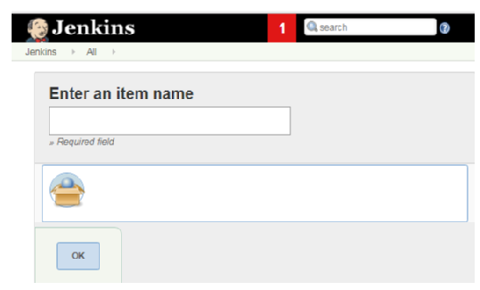
Setting Up Jenkins Environment
Jenkins environment is needed to create the NodeJS project using Jenkinsfile for the build.
Notes:
Now, let us set up the Jenkins environment where we need to create the NodeJS project using Jenkinsfile for the build.
You must have Jenkins installed on your lab to create the Jenkins Pipeline Project
We’ll start by configuring for the Angular Web-Admin Project.

Slide 14
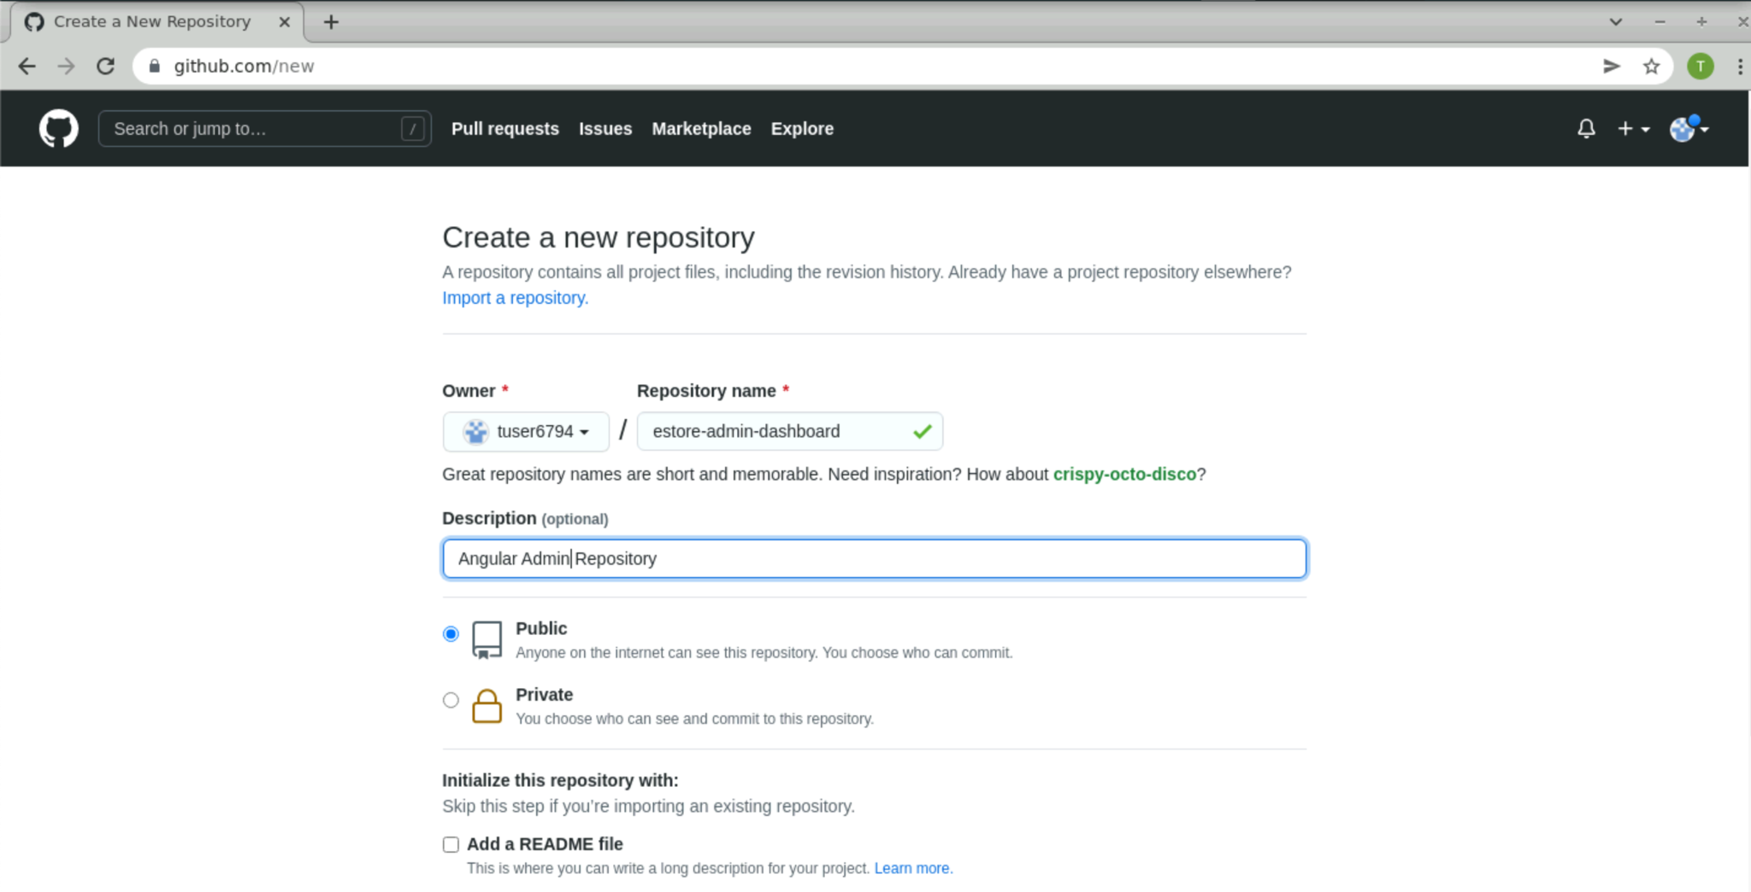
Create Git Repository on GitHub for the Web-Admin Project
Create a new repository on your GitHub account which will be used by Jenkins to sync the code in SCM.
Notes:
Create a new repository on your GitHub account. This will be used by Jenkins to sync the code in SCM.

Slide 15
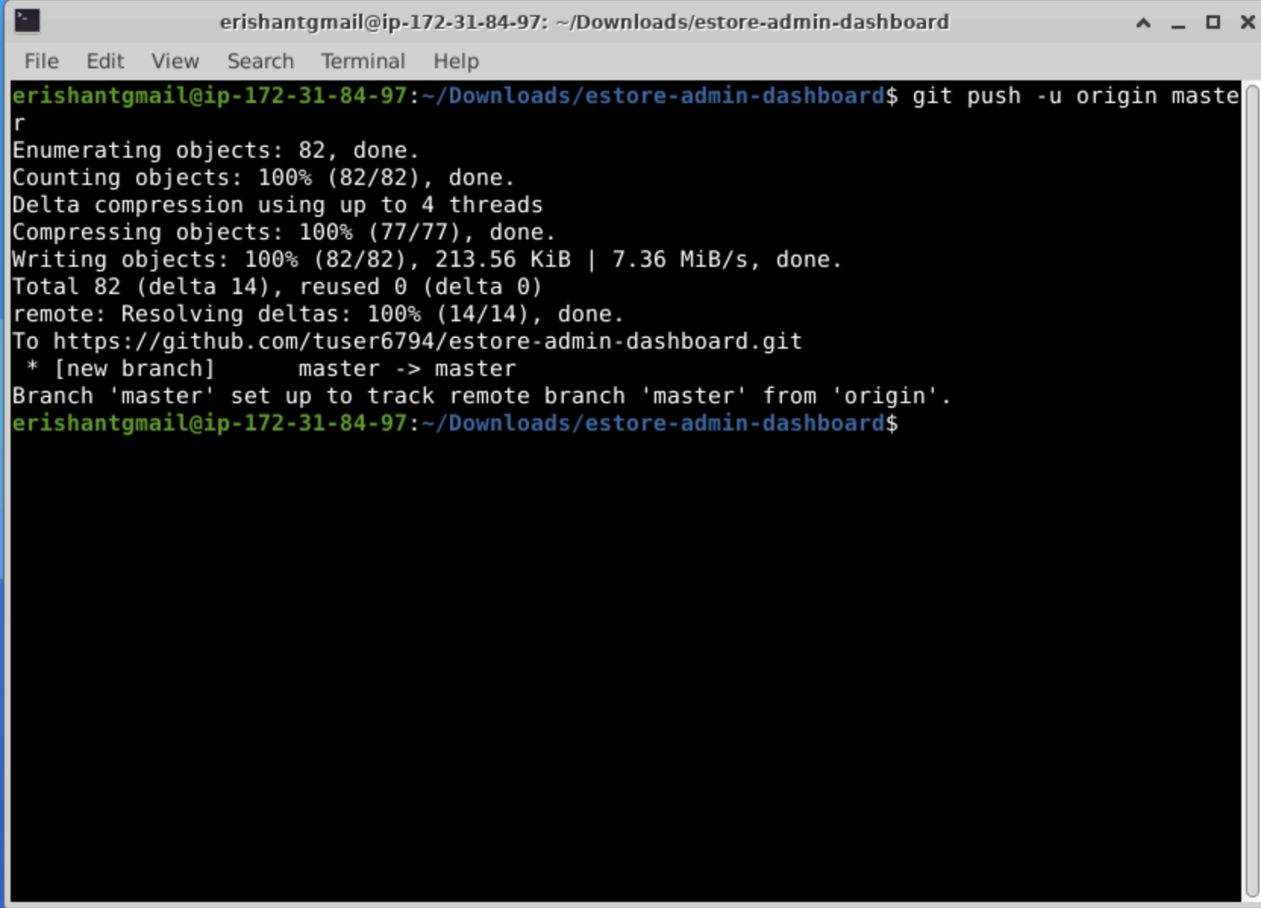
Sync the Project on GitHub for the Web-Admin Project
Push the code on GitHub for the web-admin project.
Notes:
Push the code on GitHub for the web-admin project.

Slide 16
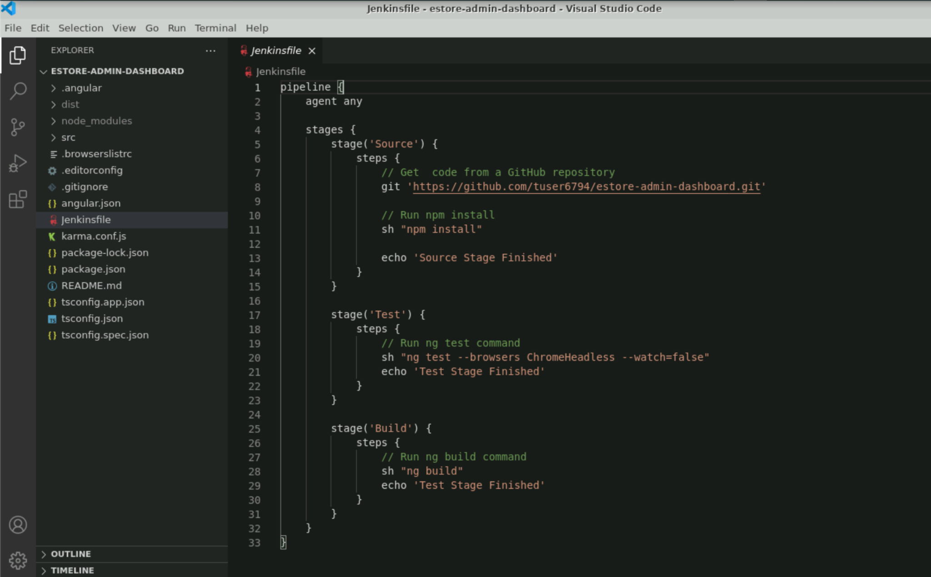
Configure Jenkins Pipeline Stages
Create a Jenkinsfile for Jenkins to build the project as a Pipeline in Jenkins.
Create Jenkinsfile in the root directory of the project and push it to GitHub so that Jenkins can use it for Pipeline.
Notes:
Now, create a Jenkinsfile for Jenkins to build your project as a pipeline in Jenkins.
We will create it in the root directory of the project and push it to the GitHub so that Jenkins can use Jenkinsfile for the Pipeline.

Slide 17
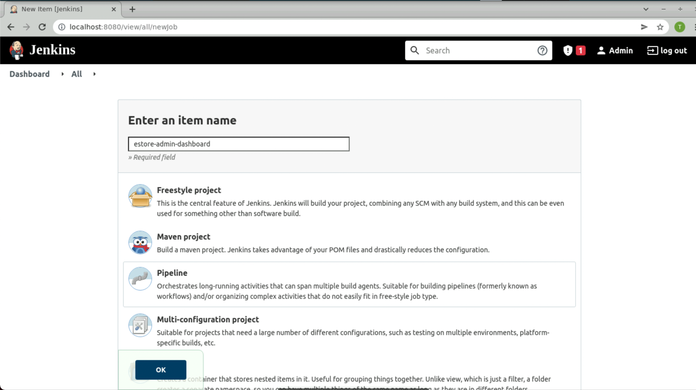
Create a Jenkins Pipeline Project for the Web-Admin Project
Create a new project in Jenkins of type Pipeline.
Notes:
Create a new project in Jenkins of type Pipeline.

Slide 18
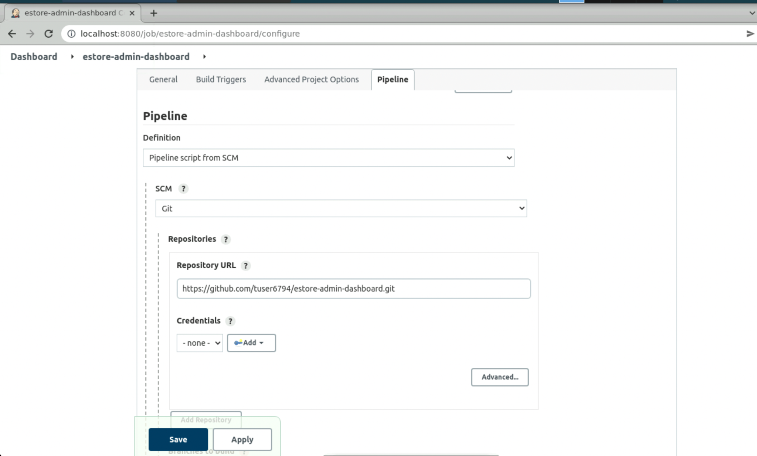
Configure Jenkins Pipeline SCM for the Web-Admin Project
Configure the Jenkins Pipeline project by passing the GitHub repository URL.
Notes:
Configure the Jenkins Pipeline Project by passing the GitHub repository URL.

Slide 19
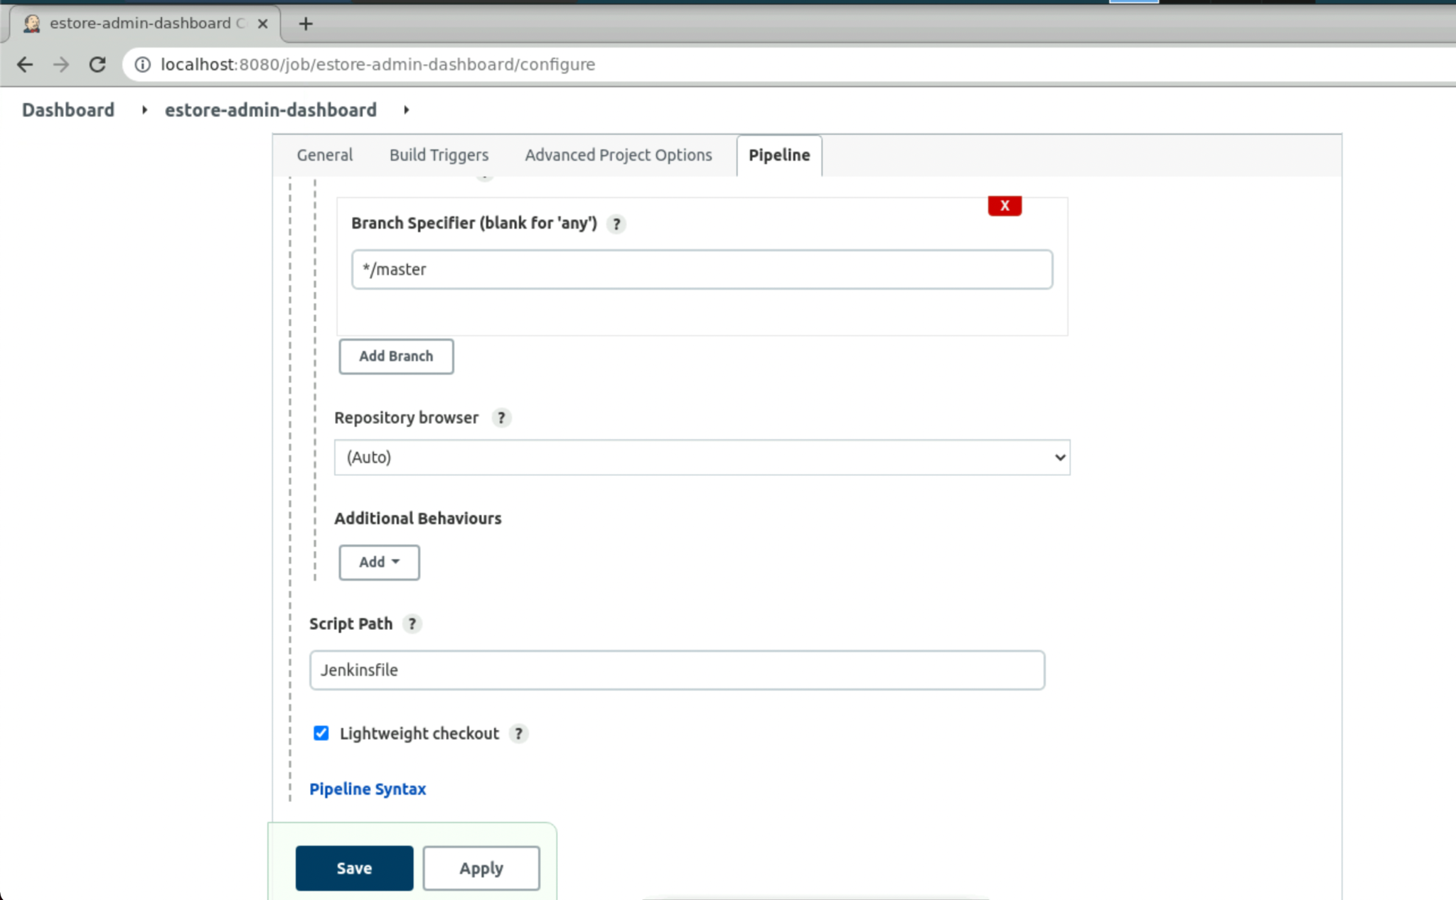
Configure Jenkinsfile in Jenkins for the Web-Admin Project
From the branch specifier, select the branch.
Select the default branch, which is master.
The Script Path contains the Jenkinsfile, which is created in the root directory of the project.
Notes:
From the branch specifier, select the default branch which is master.
The Script Path contains the Jenkinsfile, which is created in the root directory of our project.

Slide 20
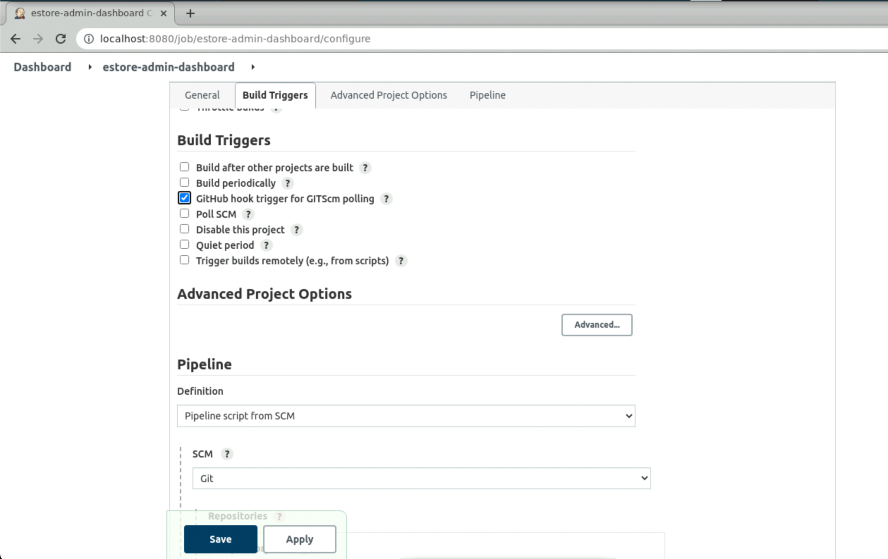
Optional: GitHub Hook Trigger for the Web-Admin Project
Configure GitHub trigger for GITScm Polling. This option will work when Jenkins is running with a proper URL instead of the localhost.
Configure the same using ngrok.
Notes:
Optional Step
Configure GitHub trigger for GITScm Polling. This option will work when Jenkins is running with a proper URL instead of localhost
You can configure the same using ngrok.

Slide 21
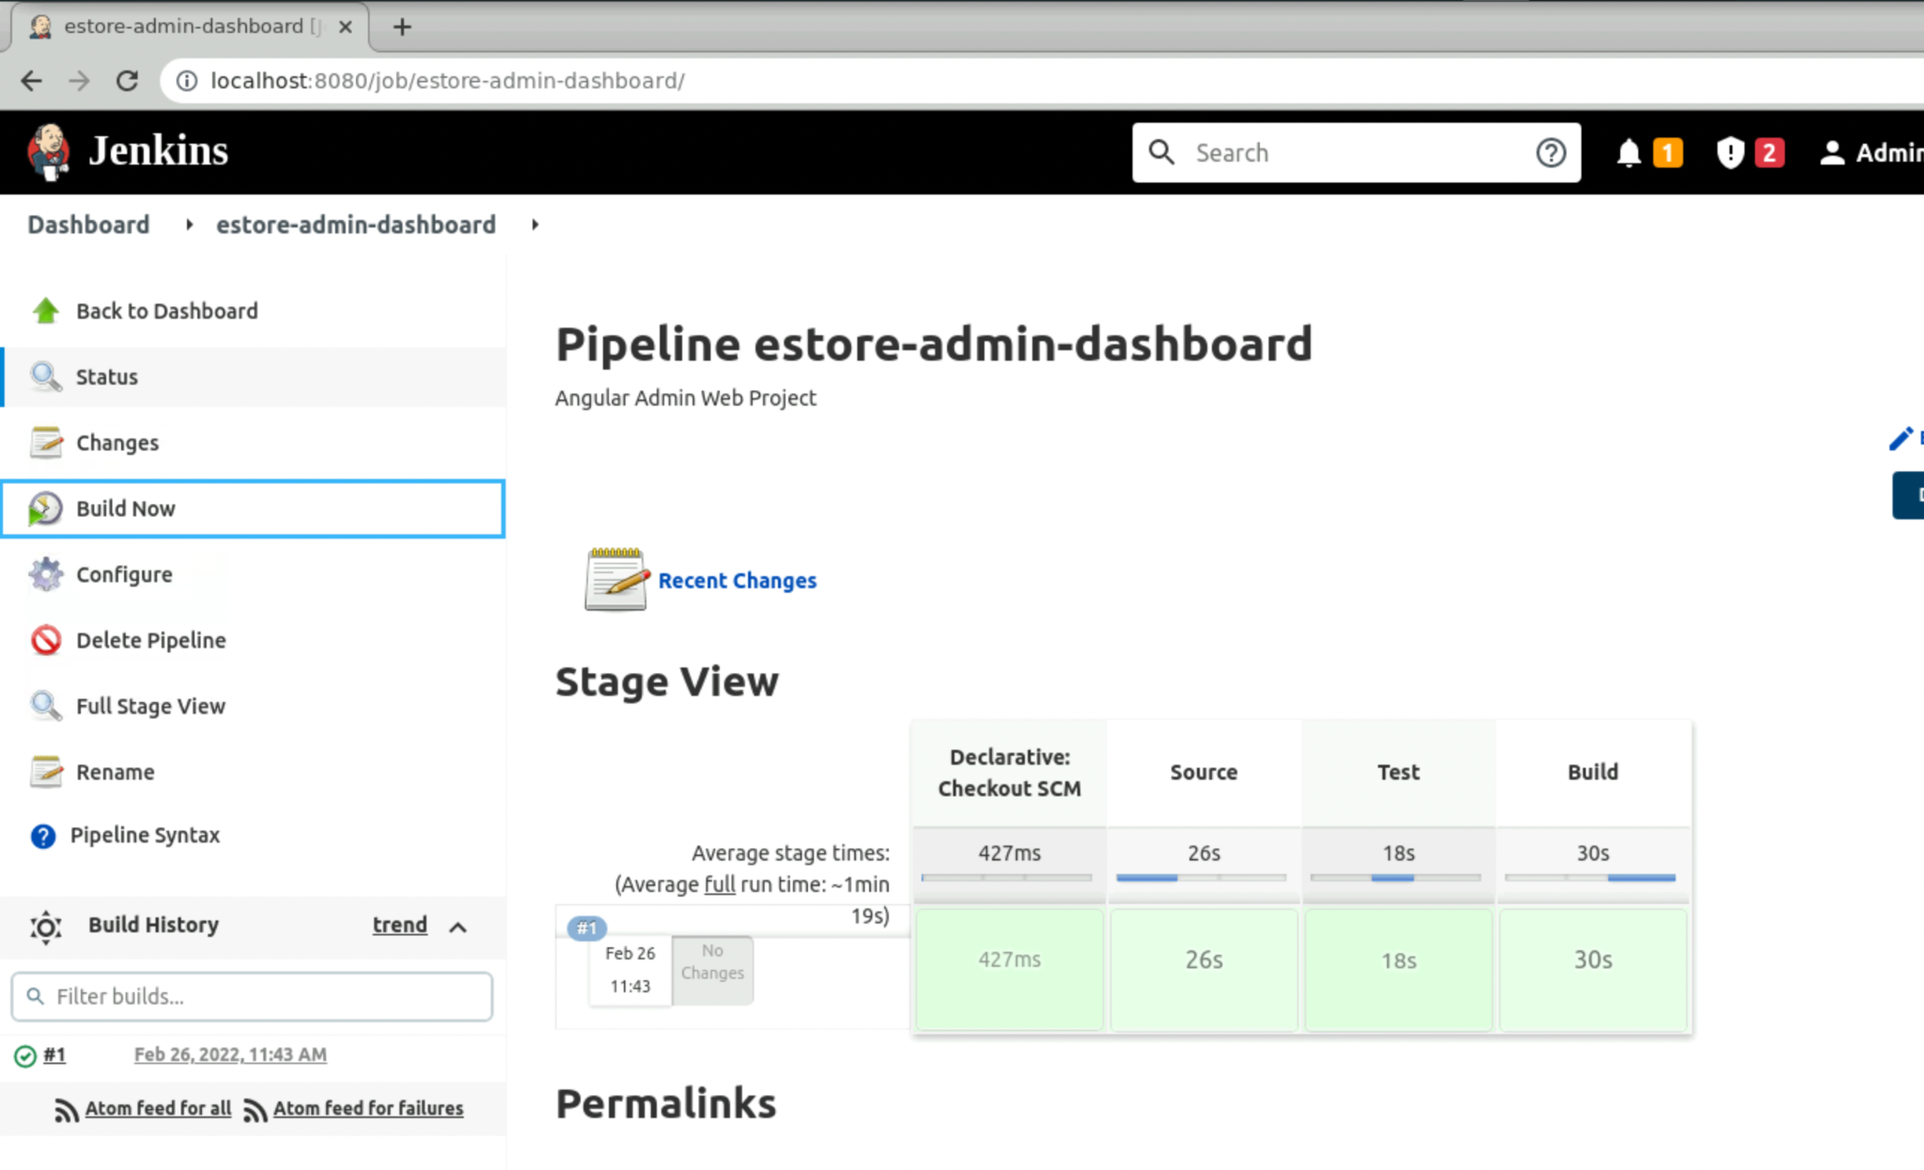
Run the Jenkins Pipeline Project for the Web-Admin Project
Notice the stages appearing as mentioned in the Jenkinsfile.
Source > Test > Build
Finally, click on Build Now and build the project.
Notes:
Finally, click on Build Now and build your project
You will notice the stages appearing as we mentioned in the Jenkinsfile
Source > Test > Build

Slide 22
Set Up Jenkins for the Angular End-User Project
Notes:
Now, we can similarly set up Jenkins for the End-User Project

Slide 23
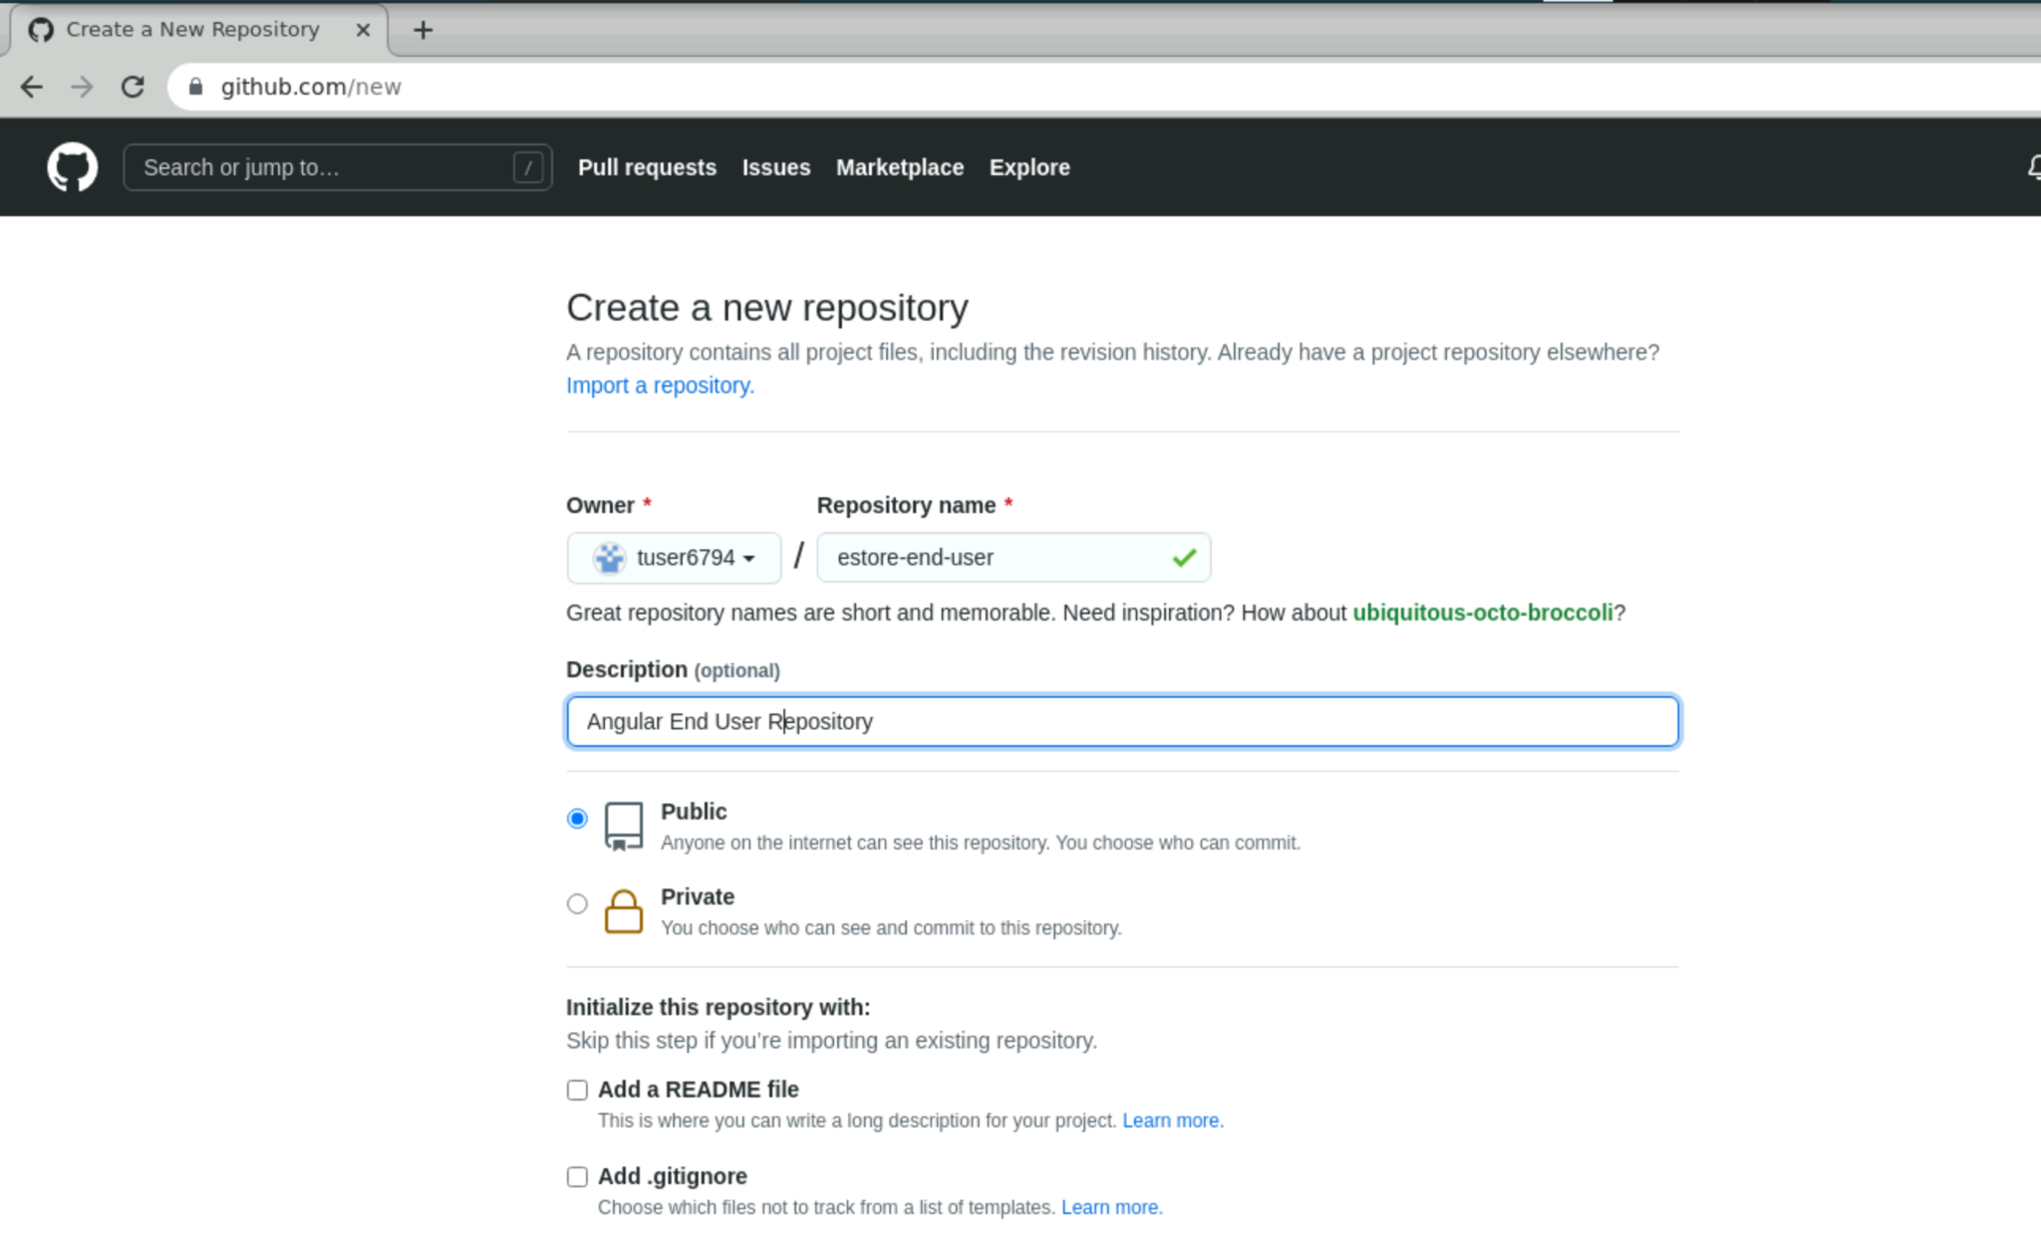
Create Git Repository on GitHub for the End-User Project
Create a new repository on your GitHub account which will be used by Jenkins to sync the code in SCM.
Notes:
Create a new repository on your GitHub account. This will be used by Jenkins to sync the code in SCM.

Slide 24
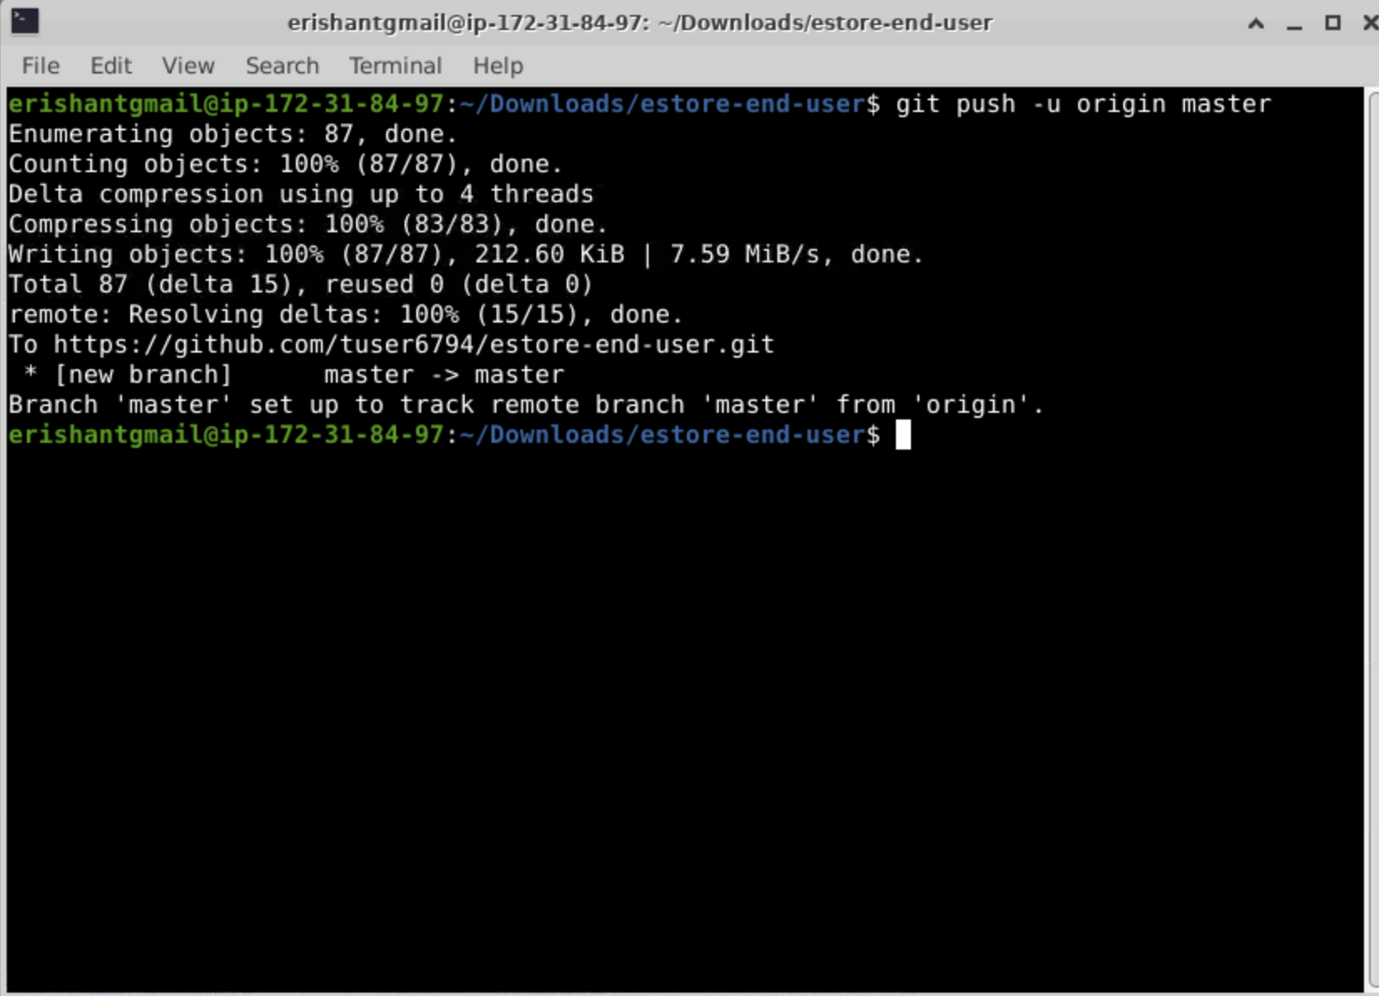
Sync the Project on GitHub for the End-User Project
Push the code on GitHub for the end-user project.
Notes:
Push the code on GitHub for the end-user project.

Slide 25
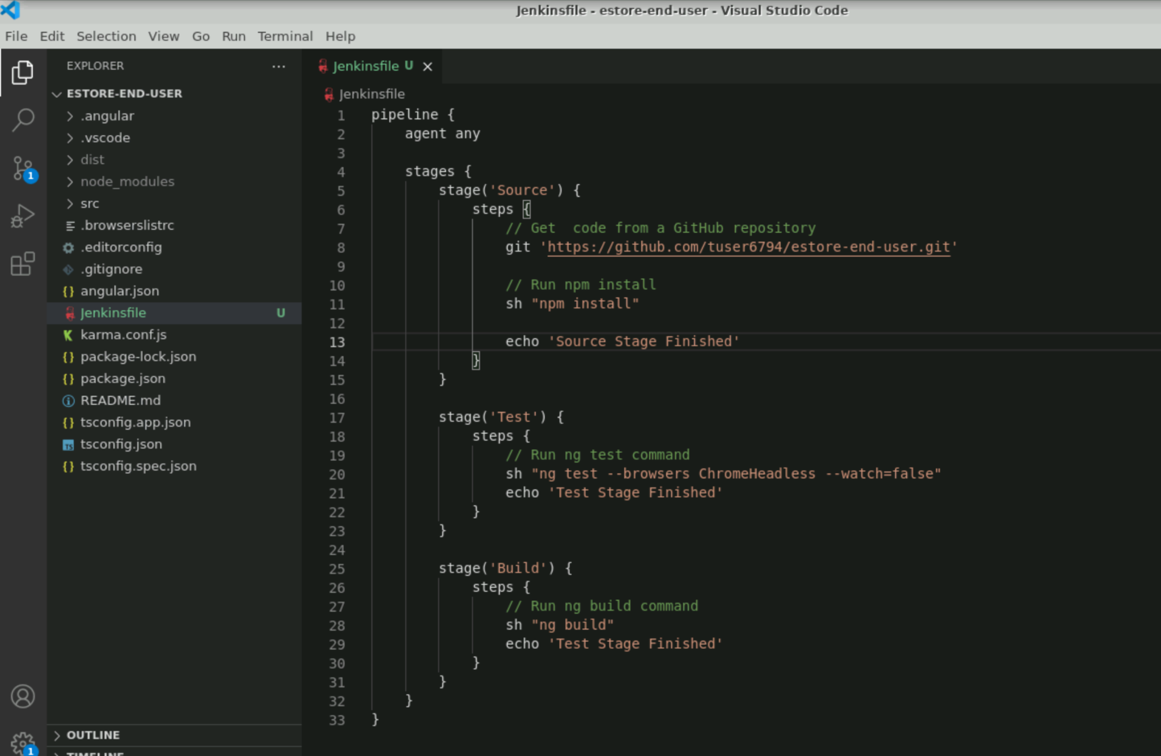
Configure Jenkins Pipeline Stages for the End-User Project
Create a Jenkinsfile for Jenkins to build project as pipeline in Jenkins.
Create Jenkinsfile in root directory of the project and push it to GitHub so that Jenkins project can use it for Pipeline.
Notes:
Now, create a Jenkinsfile for Jenkins to build your project as pipeline in Jenkins.
We will create it in the root directory of the project and push it to the GitHub so that Jenkins Project can use Jenkinsfile for Pipeline.

Slide 26
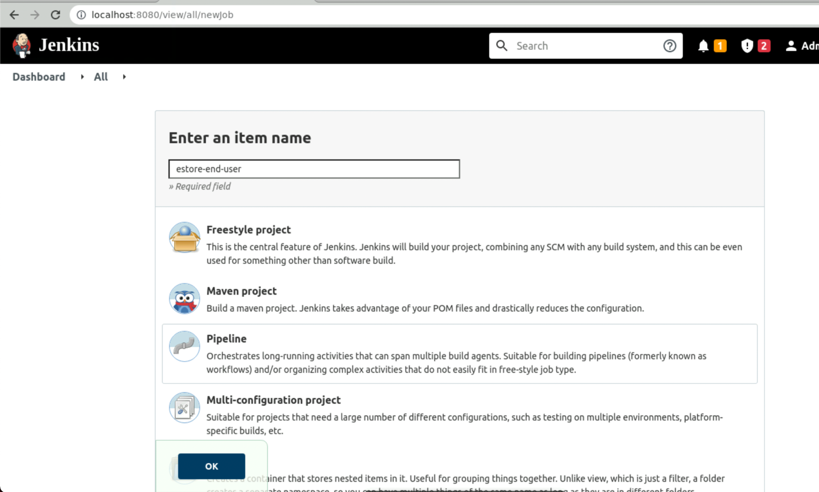
Create a Jenkins Pipeline Project for the End-User Project
Create a new project in Jenkins of type Pipeline.
Notes:
Create a new project in Jenkins of type Pipeline.

Slide 27
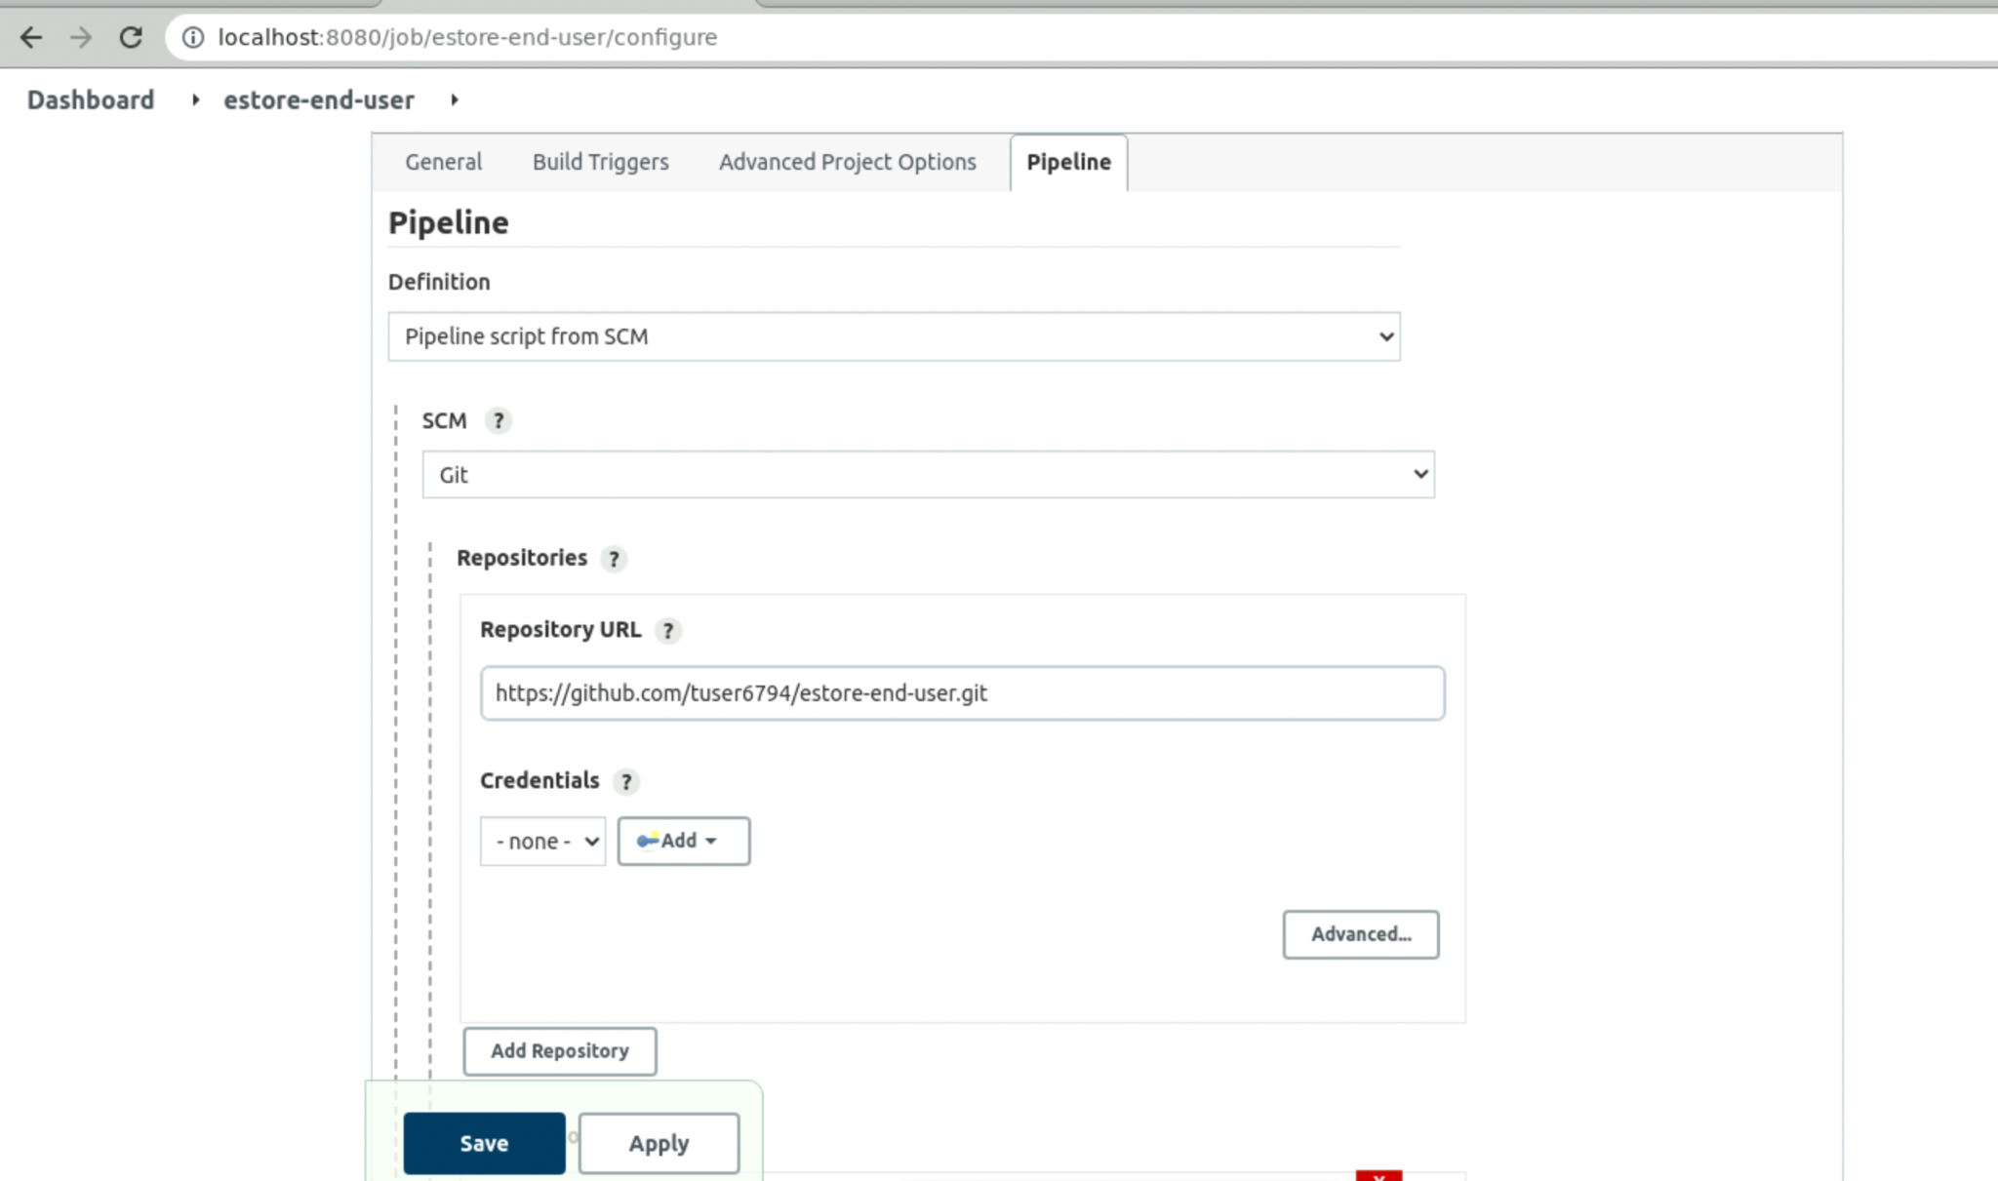
Configure Jenkins Pipeline SCM for the End-User Project
Configure the Jenkins Pipeline Project by passing the GitHub Repository URL.
Notes:
Configure the Jenkins Pipeline Project by passing GitHub Repository URL.

Slide 28
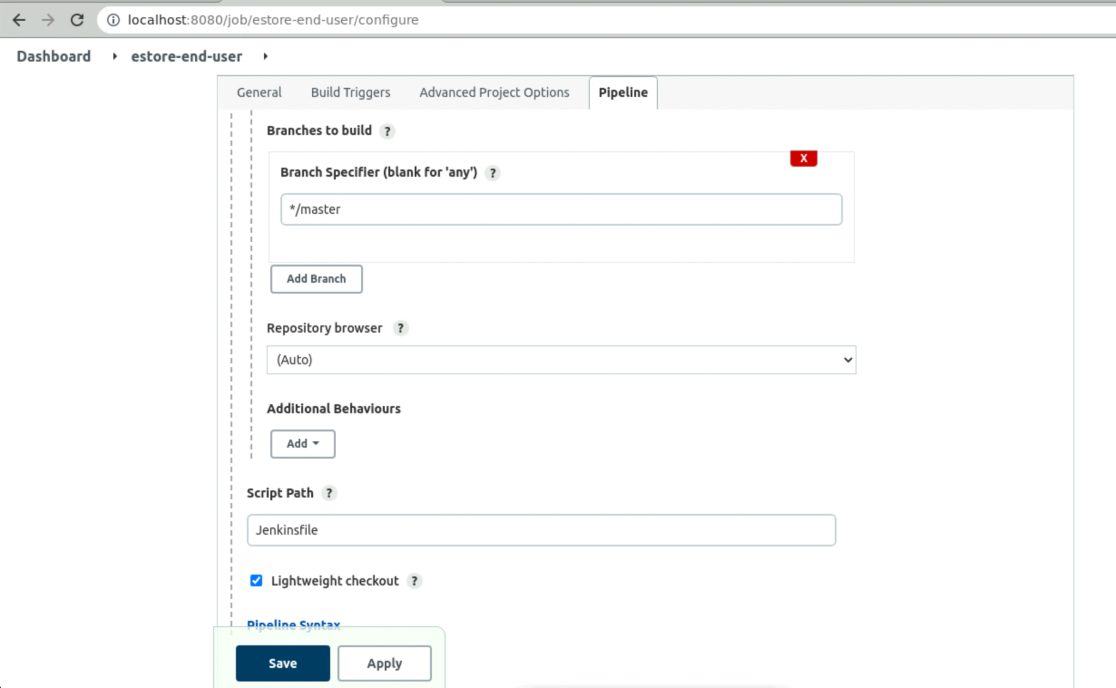
Configure Jenkinsfile in Jenkins for the End-User Project
From the branch specifier, select the branch.
Select the default branch, which is master.
Script Path contains the Jenkinsfile, which is created in the root directory of the project.
Notes:
From the branch specifier, select the default branch which is master.
Script Path contains the Jenkinsfile which is created in the root directory of our project.

Slide 29
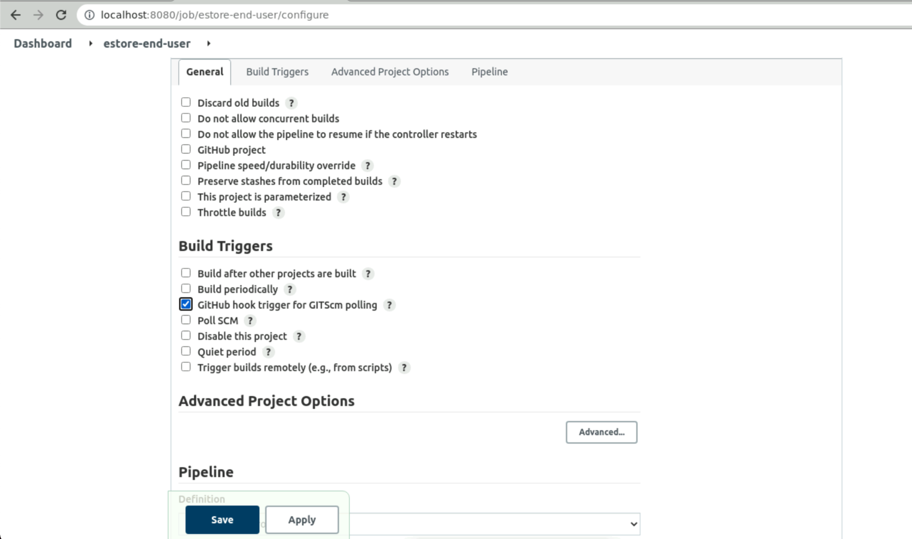
Optional: GitHub Hook Trigger for the End-User Project
Configure GitHub trigger for GITScm Polling. This option will work
when Jenkins is running with a proper URL instead of the localhost.
Configure the same using ngrok.
Notes:
Optional Step
Configure GitHub trigger for GITScm Polling. This option will work when Jenkins is running with a proper URL instead of localhost
You can configure the same using ngrok.

Slide 30
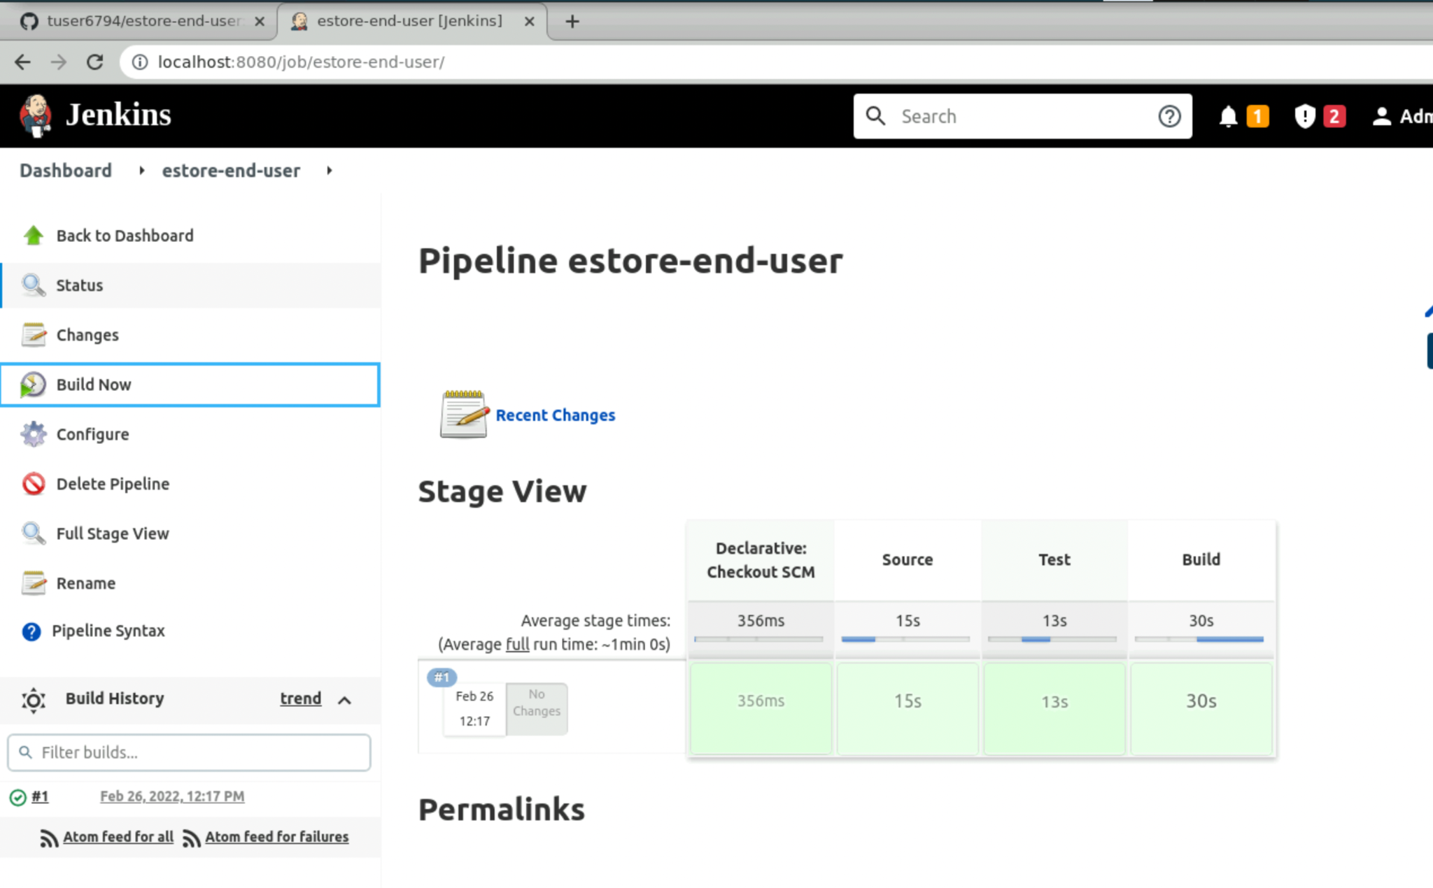
Run the Jenkins Pipeline Project for the End-User Project
Notice the stages appearing as mentioned in the Jenkinsfile.
Source > Test > Build
Finally, click on Build Now and build the project.
Notes:
Finally, click on Build Now and build your project
You will notice the stages appearing as we mentioned in the Jenkinsfile
Source > Test > Build

Slide 31
Containerize the Angular Web-Admin Project
Notes:
For Angular NodeJS, let us write the Dockerfile which will build the image for our web-admin project

Slide 32
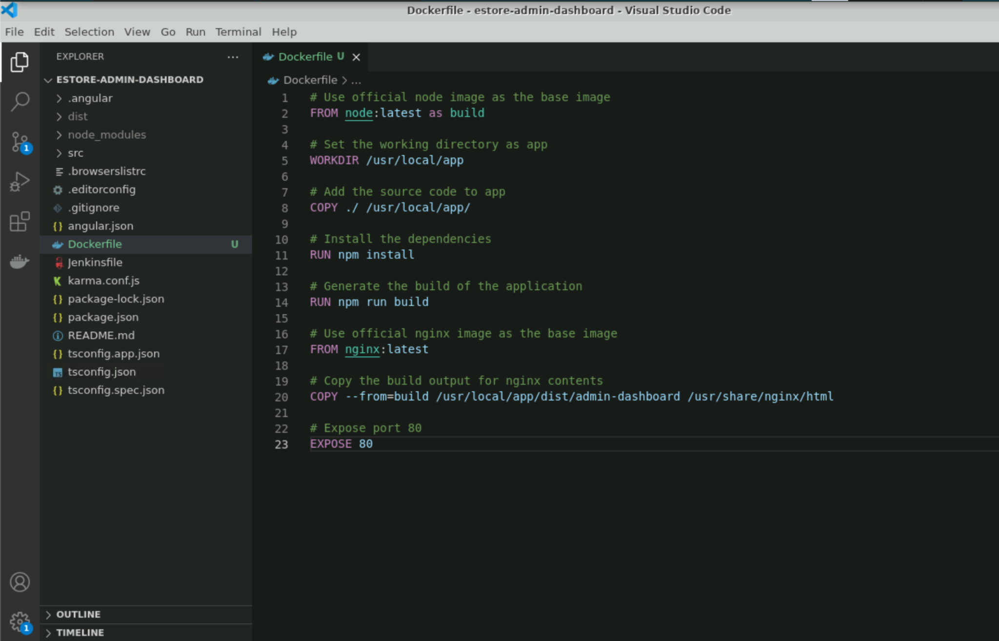
Configure Docker Using Dockerfile for the Web-Admin Project
The Dockerfile is a multi-stage docker build with two stages:
Building the angular project into dist directory for production.
Serving the application using NGINX web server on port 80.
Notes:
Let us write the Dockerfile which will be used to dockerize our angular application with a NGINX server.
The Dockerfile is a multi-stage docker build with two stages:
Building the angular project into dist directory for production.
Serving the application using a NGINX web server on port 80.

Slide 33
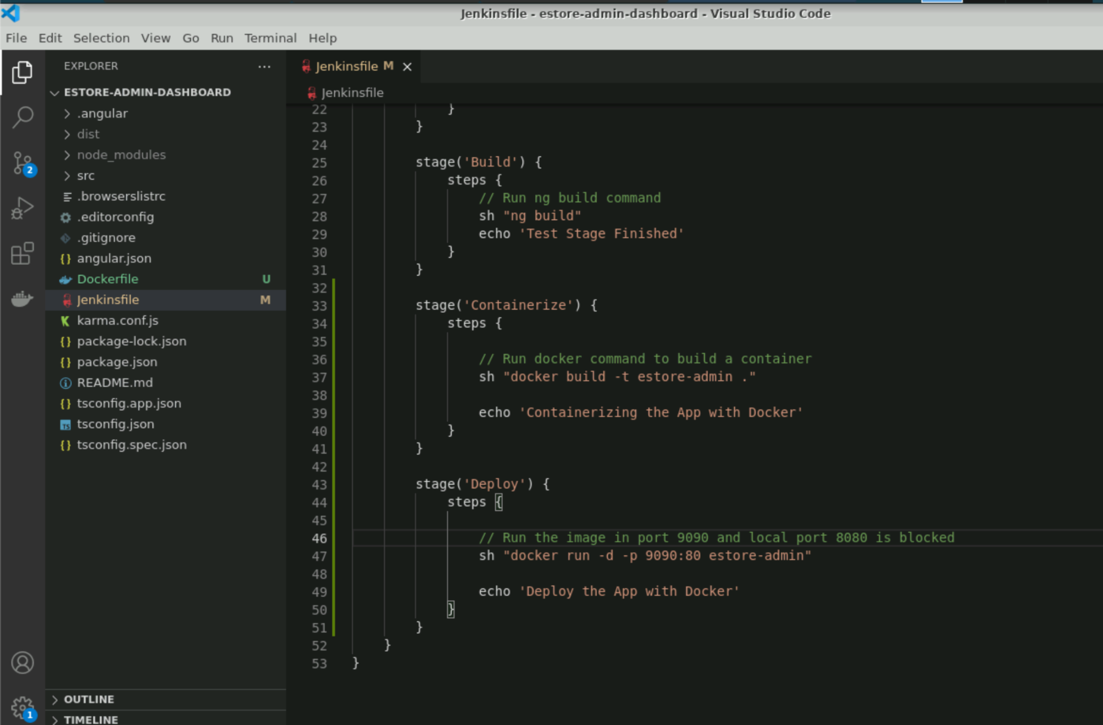
Configure Jenkins Pipeline Stages for Docker
Add the stages for containerizing the Angular web admin that is building and running container.
Create it in the root directory of project and push it to GitHub so that Jenkins Project can use Jenkinsfile and Dockerfile.
Notes:
Now, in the already created Jenkinsfile, let us add the stages for containerizing the Angular web admin i.e. building and running the container finally
We will create it in the root directory of the project and push it to the GitHub so that the Jenkins Project can use Jenkinsfile and Dockerfile.

Slide 34
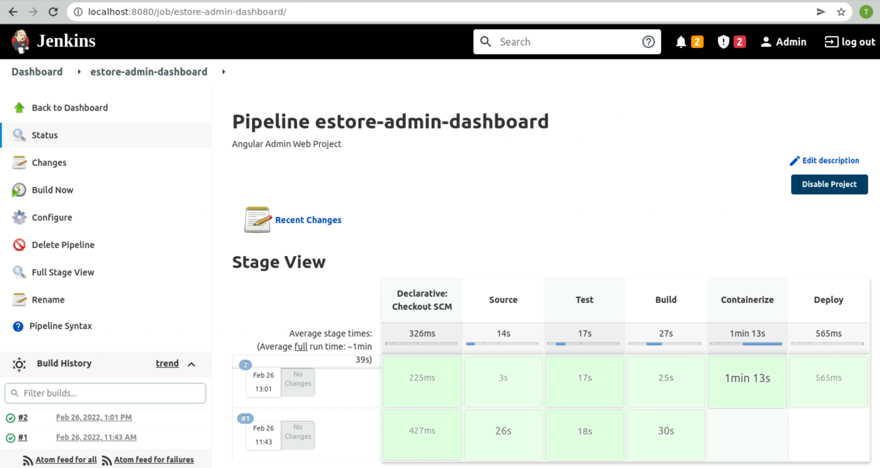
Run the Jenkins Pipeline Project for the Web-Admin Project
Notice stages appearing as mentioned in the Jenkinsfile.
Source > Test > Build > Containerize > Deploy
Click on Build Now and build the project.
Notes:
Now, click on Build Now and build your project
You will notice the stages appearing as we mentioned in the Jenkinsfile
Source > Test > Build > Containerize > Deploy

Slide 35
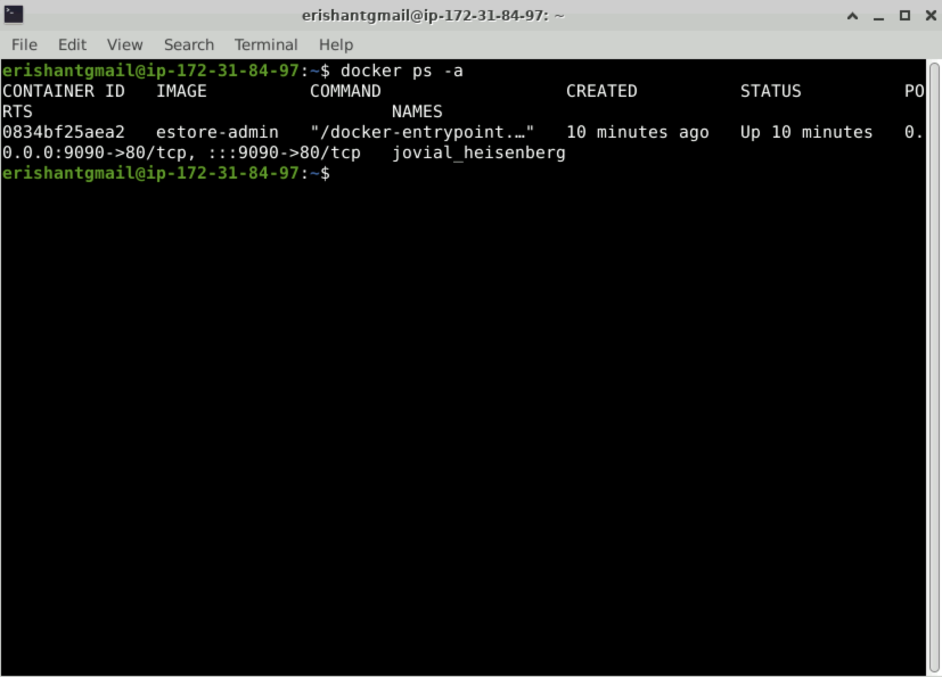
Check Docker ps -a
Check the status of running container by docker ps –a, which is a command to validate Jenkins build.
Notes:
You can check the status of the your running container by docker ps –a, which is a command to validate the Jenkins build.

Slide 36
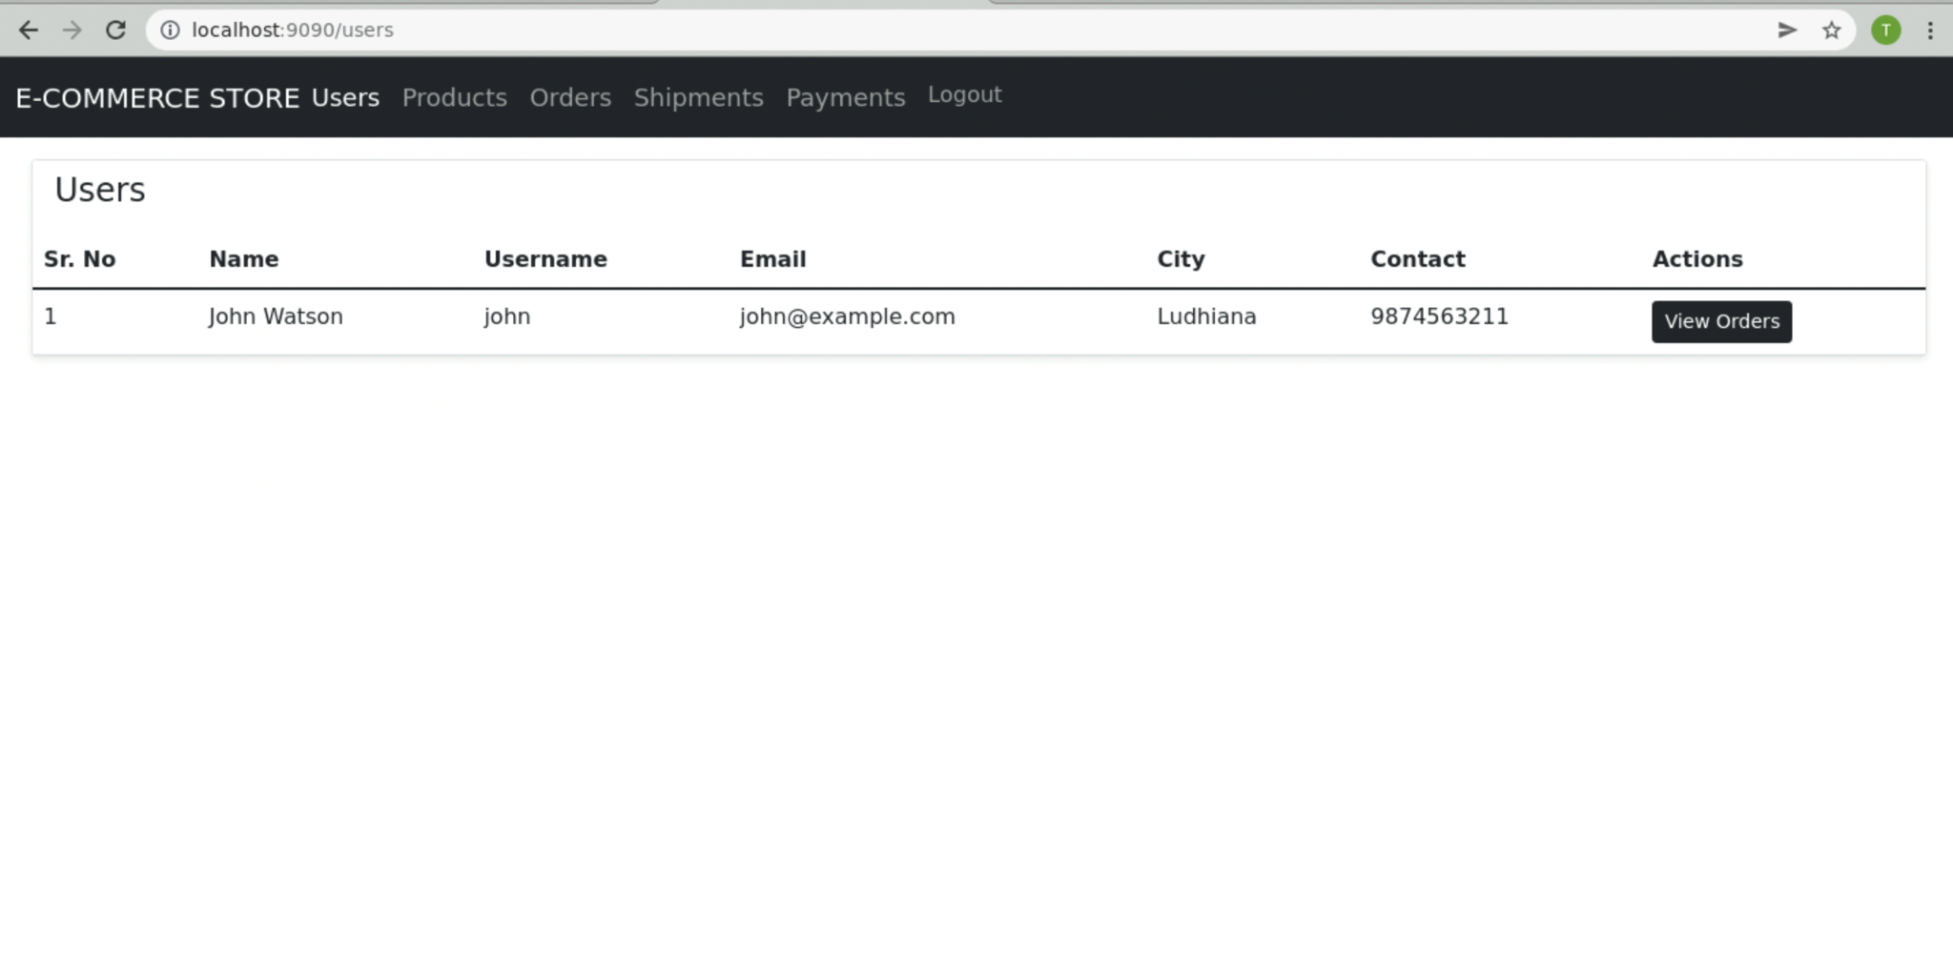
Check the Web-Admin Project on Localhost
The web-admin project is up and running in a docker container.
Notes:
The web-admin project is up and running in a docker container.

Slide 37
Dockerise the Pipeline

Slide 38
Containerize Angular End-User Project
Notes:
For Angular NodeJS, let us write the Dockerfile which will build the image for our End-User Project.

Slide 39
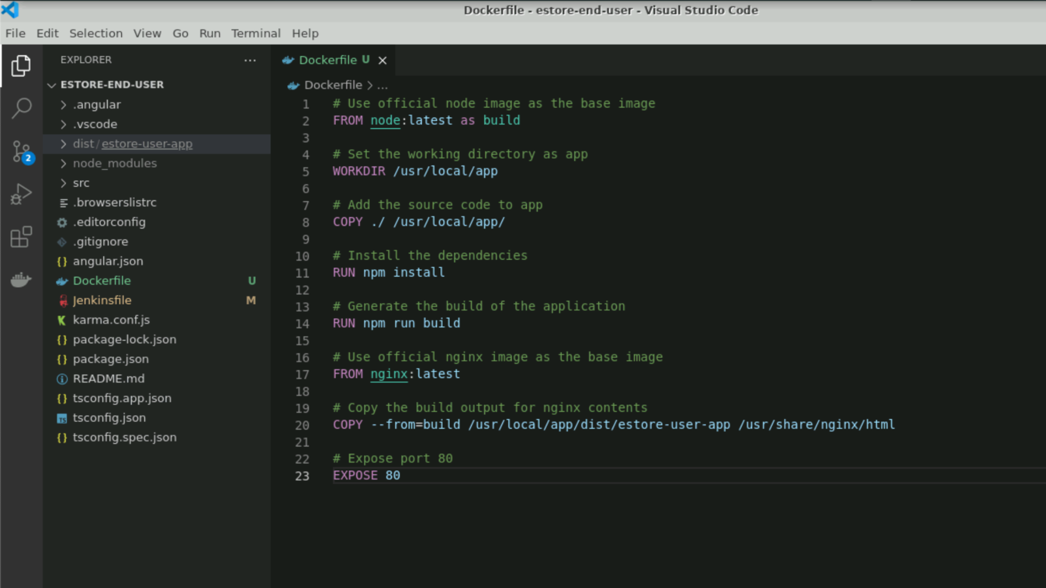
Configure Docker Using Dockerfile for the End-User Project
The Dockerfile is a multi-stage docker build with two stages:
Building the angular project into dist directory for production.
Serving the application using NGINX web server on port 80.
Notes:
Let us write the Dockerfile which will be used to dockerize our angular application with a NGINX server.
The Dockerfile is a multi-stage docker build with two stages:
Building the angular project into dist directory for production.
Serving the application using a NGINX web server on port 80.

Slide 40
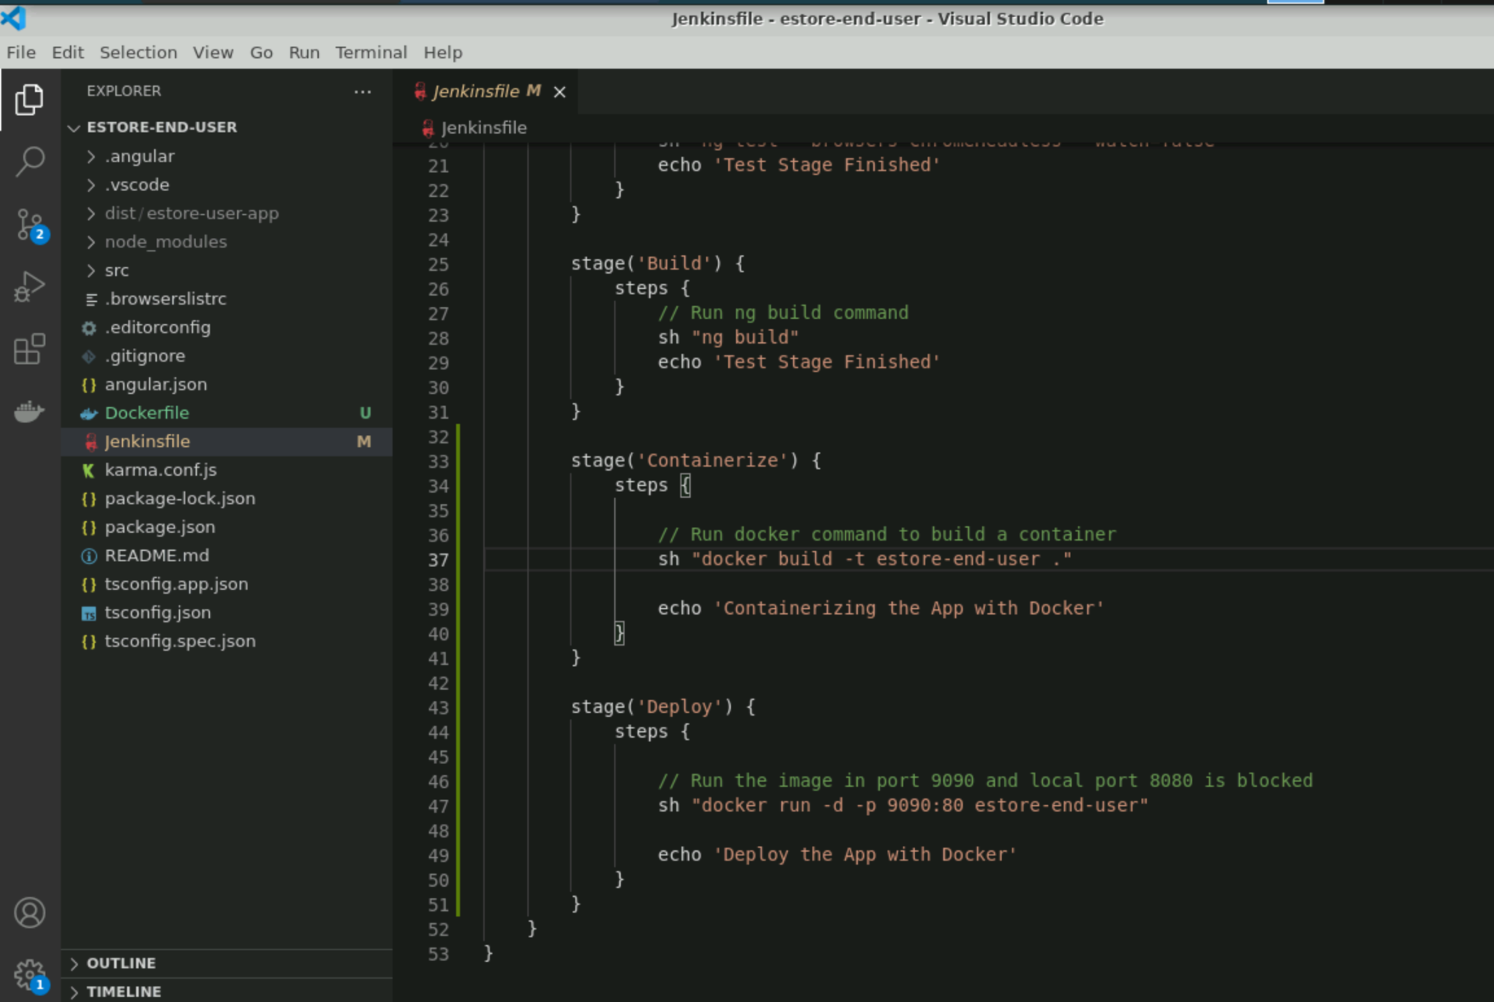
Configure Jenkins Pipeline Stages for Docker
Add the stages for containerizing the Angular web admin that isnbuilding and running container.
Create it in root directory of the project and push it to GitHub so that Jenkins project can use Jenkinsfile and Dockerfile.
Notes:
Now, in the already created Jenkinsfile, let us add the stages for containerizing the Angular Web Admin i.e. building and running the container finally
We will create it in the root directory of the project and push it to the GitHub so that Jenkins Project can use Jenkinsfile and Dockerfile

Slide 41
Run the Jenkins Pipeline Project for the End-User Project
Notice stages appearing as mentioned in the Jenkinsfile.
Source > Test > Build > Containerize > Deploy
Click on Build Now and build project.
Notes:
Now, click on Build Now and build your project
You will notice the stages appearing as we mentioned in the Jenkinsfile
Source > Test > Build > Containerize > Deploy

Slide 42
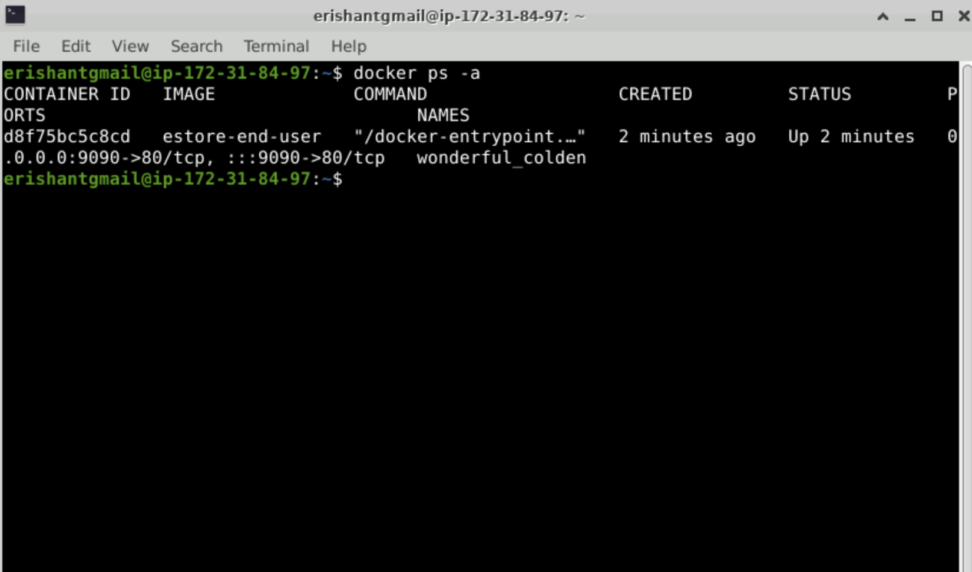
Check Docker ps -a
Check status of running container by docker ps –a, which is a command to validate Jenkins build.
Notes:
You can check the status of the your running container by docker ps - a command to validate the Jenkins build

Slide 43
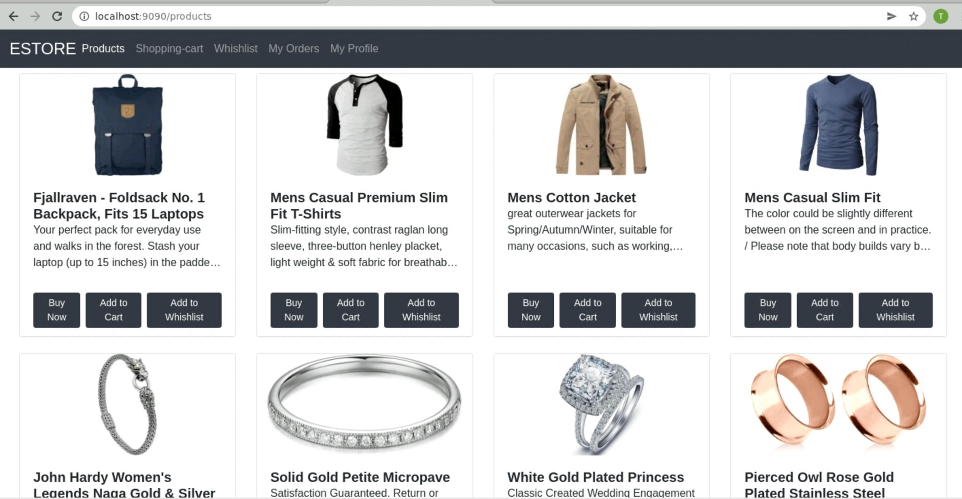
Check the End-User Web Project on Localhost
The End-user web project is up and running in a docker container.
Notes:
The End-user web project is up and running in a docker container.

Slide 44
Jenkins is an automation build server.
Jenkins Pipeline for Angular apps is set using Jenkinsfile.
Dockerfile is used to dockerize the Angular apps.
Jenkins Pipeline is built to dockerize the Angular apps.

Slide 46
Where will you declare Pipeline for Jenkins project?
01
Jenkinsfile
pipeline.jenkins
JenkinsPipeline
Pipeline

Slide 47
Where will you declare Pipeline for Jenkins project?
01
Jenkinsfile
pipeline.jenkins
JenkinsPipeline
Pipeline
A
Configure the Jenkins Pipeline in Jenkinsfile by creating multiple stages.

Slide 48
Choose the correct option.
02
In Jenkinsfile, we have steps which contain stages.
In Jenkinsfile, we have stages which contain steps.
In Jenkinsfile, we have only stages.
In Jenkinsfile, we have only steps.

Slide 49
Choose the correct option.
02
In Jenkinsfile, we have steps which contain stages.
In Jenkinsfile, we have stages which contain steps.
In Jenkinsfile, we have only stages.
In Jenkinsfile, we have only steps.
B
Jenkinsfile can have multiple stages, and each stage can have steps.

Slide 50
In order to dockerize, how do you use base image in Dockerfile?
03
COPY
RUN
EXPOSE
FROM

Slide 51
In order to dockerize, how do you use base image in Dockerfile?
03
COPY
RUN
EXPOSE
FROM
D
We can use the base image using FROM, e.g., FROM node:latest as build.

Slide 52
How can you execute commands in Dockerfile?
04
RUN
EXECUTE
SH
All of the above

Slide 53
How can you execute commands in Dockerfile?
04
RUN
EXECUTE
SH
All of the above
A
We can use RUN to execute the commands, e.g., RUN npm run build.

Slide 54
How can you run the container on a specific port in docker?
05
docker run -d 9090:80 estore-end-user
docker run -p 9090:80 estore-end-user
docker run -dp 9090:80 estore-end-user
Both B and C

Slide 55
How can you run the container on a specific port in docker?
05
docker run -d 9090:80 estore-end-user
docker run -p 9090:80 estore-end-user
docker run -dp 9090:80 estore-end-user
Both B and C
D
You can use -p or -dp to run the image as container.

Slide 56
Before the Next Class
You have successfully completed this session.
Before the next discussion, you should go through:
AWS

Slide 57
What’s Next?
Now we have finished our classes and design pattern for the back-end project with respect to end-user module. In our next live session, we will:
See how to create Jenkins Pipeline for Java back end
See how to work with Jenkinsfile for the Maven project
Learn various commands in Dockerfile for the Java back-end project
Explore CI/CD Pipeline with Jenkins

